Slide 1
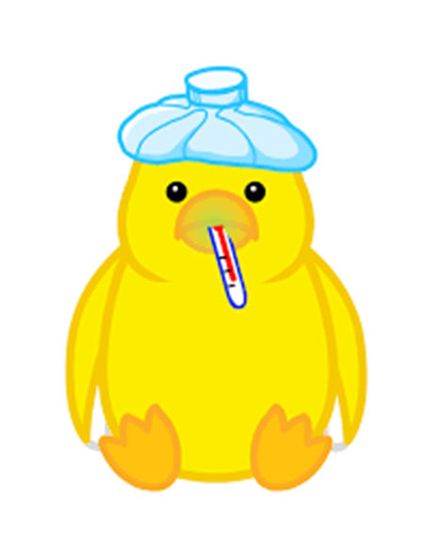
poultry diseases
fourth stage
شعار الكلية
Vitamin B Deficiency
Dr.Harith Abdulla
Department of Pathology and Poultry Disease
College of veterinary medicine university of basrah
University of Basrah- College of veterinary medicine- Department of Pathology and Poultry Disease

Slide 2
Introduction
The B complex vitamins are water soluble and not stored to any significant extent in the body. They act in a broad range of metabolic pathways.
Simple deficiency is now rare as diets are usually well supplemented. However, because a continuous supply is required, damage to the intestine or increased demand for some reason may have an effect.

Slide 3
Introduction 2
Most will reduce productivity, including growth in the young animal, and egg production in the layer.
The embryo is particularly dependent on having adequate supplies of vitamins deposited in the egg.
Vitamin deficiencies are especially prone to cause problems of hatchability.

Slide 4
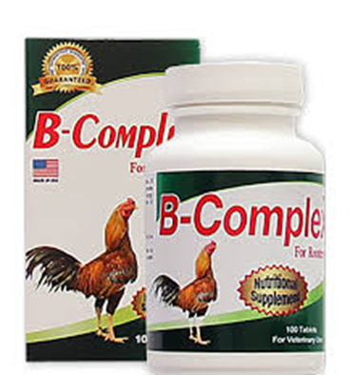
Vitamin B Deficiency
1-Pantothenic acid and Biotin Deficiency.
2- Thiamine Deficiency ( B1 Deficiency ).
3- Riboflavin ( B2) Deficiency .

Slide 5
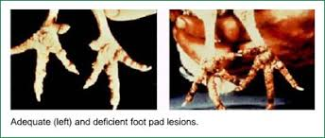
1-Chick Dermatitis (Pantothenic acid and Biotin Deficiency )

Slide 6
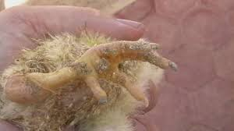
Chick Dermatitis
An inflammation of the unfeathered parts of
chicks and poults caused by deficiency of
vitamin B5 ( pantothenic acid) and biotin B7.
Symptoms:
1-Slow growth and rigid feathers.
2-Low hatchability and high embryonic
mortality.

Slide 7
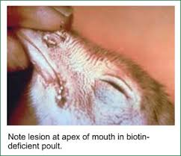
Post-mortem lesions:
1-Pus like substance in the mouth and grayish white exudates in the prventriculus.
2-Scabby lesions at the corners of the mouth, edge of eyelids, around the vent and bottom of the feet ( Dermatitis).
3- Liver is hypertrophied , spleen sometimes
atrophied.
Treatment:
Injection or oral
administration of
the vitamin.

Slide 8
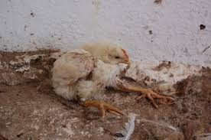
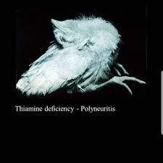
2- Thiamine Deficiency ( B1 Deficiency )
( Polynuritis )
Function of Thiamine ( B1) Thiamine is required by poultry for the metabolism of carbohydrate.
In birds, vitamin B1, (thiamine) deficiency is clinically and morphologically manifested with Stargazing

Slide 9
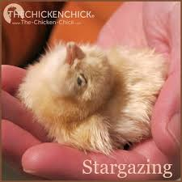
Symptoms:
1-Symptoms appear in 2-3 weeks after chicks were placed on thiamine deficient diet.
2-Anorexia followed by loss of weight, leg weakness and unsteady gait.
3-Paralysis of muscles of legs, wings and neck.
4-The chicken characteristically
sits on its flexed legs and
draws the head back in a
*Stargazing* position.

Slide 10
Post-mortem lesions: Bilateral enlargement of nerves(Sciatic ).
Treatment :
The bird response quickly with oral administration
of thiamine.

Slide 11
3- Riboflavin ( B2) Deficiency
(Curled Toe Paralysis)
is characterized with impaired oxidation processes and dystrophic changes in the peripheral nerves.

Slide 12
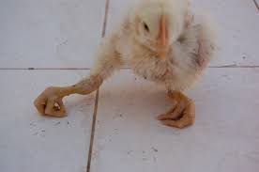
Curled Toe Paralysis:
Is a nutritional disease
caused by vitamin B2
deficiency.
Symptoms:
1-Age : 3-4 weeks.
2-Diarrhea develops between the first and second week.
3-The chicks do not walk unless forced, and walk with the aid of wings.

Slide 13
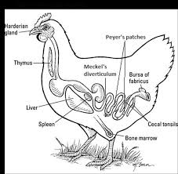
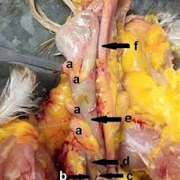
Post-mortem lesions:
1-Atrophied thymus gland.
2-Enlargement of nerves,
4-5 times, due to edema.
3- Notched beak.
Treatment:
High riboflavin diet.

Slide 14
Vitamin K =
Vitamin K is known as the clotting vitamin. The body needs vitamin K to make certain proteins in the liver that cause blood to clot. These proteins are called clotting factors. Without vitamin K, the liver could not produce clotting factors. Vitamin K is a fat-soluble vitamin stored in fat tissue and the liver.
vitamin K: quinones: It includes vitamins K1 (phylloquinones) and K2 (menaquiones), which originate from plants or bacteria, respectively.

Slide 15
is essential for synthesis of prothrombin, thus it plays an important role in clotting mechanisms and also has a protective effect against coccidiosis.
some of fungal toxins and sulfa drug causes vit k deficiency

Slide 16
Clinical Signs and Pathology of Deficiency
Deficiency of vitamin K may cause an increase of blood spots in eggs, haemorrhages in the legs and breast and a failure of blood clotting.
In growing chicks, signs of vitamin K deficiency occur as early as 2–3 weeks; hemorrhages appear externally at areas that receive abrasions
such as the feet and wings

Slide 17
pathology:
Internally, petechial hemorrhages in the liver
and erosion in the lining of the gizzard may occur.
Chicks show an anemia that may result partly from loss of blood but also from development of a hypoplastic bone marrow.

Slide 18
Inadequate vitamin K in breeder diets causes increased embryo mortality late in incubation . Dead embryos appear hemorrhagic
In diagnosis
Blood-clotting time is a fairly good measure of vitamin K deficiency, a more accurate one is obtained by determining prothrombin time.

Slide 19
Treatment of Deficiency
Within 4–6 hours after vitamin K is administered to deficient chicks,blood clots normally,
but recovery from anemia or disappearance of hemorrhages cannot be expected to take place promptly.
25 mg/kg of vit k in feed is enough to prevent its deficiency
Increase this dose when treating with sulfa drugs

